Slide 1
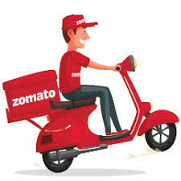
Zomato Restaurant Expansion
Data-Driven Insights and Suggestions
Asiya Shaikh

Slide 2

Agenda
Introduction
Problem Statement
Objective
High Demand Areas
Countrywise Ratings
Cost Comparison
Expansion Opportunity
Zomato Restaurant Analysis
Dashboard
Conclusion

Slide 3
Introduction
Overview of Zomato's Expansion Needs
Zomato's Growth:
Zomato is a leading online restaurant discovery and food delivery platform.
The company aims to expand its presence by opening new restaurants in key markets, particularly those with high customer demand and untapped potential.
Expansion Challenges:
While Zomato has a strong online platform, determining where to open new restaurants is a complex task.
Factors like competition, customer preferences, local demographics, and demand for specific cuisines need to be carefully analyzed to ensure successful expansion.

Slide 4

Problem Statement
You are hired as a consultant data analyst by Zomato where the team is looking for expansion and opening more restaurants.
Your task is to develop strategies/suggestions for opening newer restaurants.

Slide 5
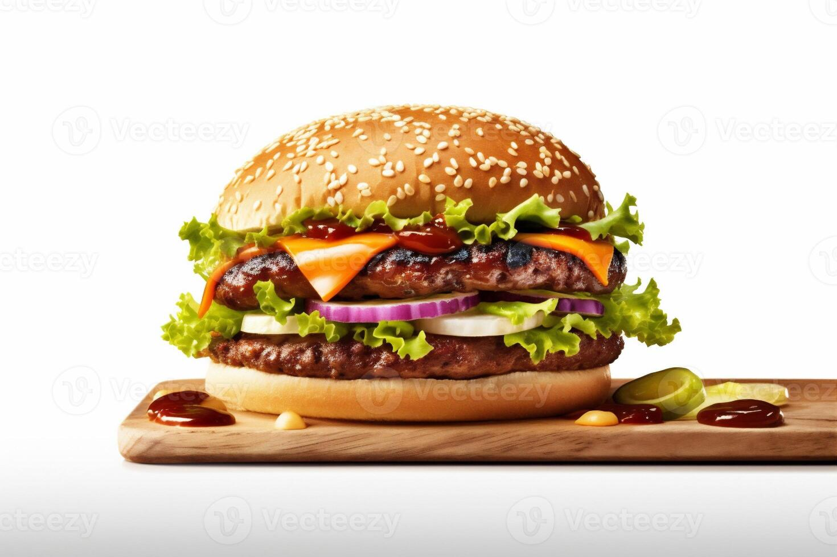
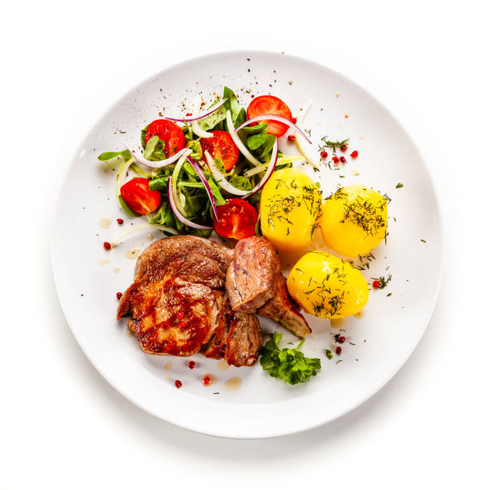
Objective
The main objective is to analyze key data points and provide strategic recommendations to Zomato for opening new restaurants in high-potential areas.
Focus will be on using data-driven insights to understand:
Customer Preferences: What types of food and cuisines are most sought after by consumers?
Market Gaps: Which regions have high demand but fewer restaurant options?
Data-Driven Decisions: In the restaurant industry, making decisions based on data is crucial. By understanding patterns in customer behavior, competition, and market trends, Zomato can strategically place new restaurants where they will succeed.
Maximizing ROI: Identifying the right location, cuisine type, and restaurant concept helps Zomato maximize returns on investment and minimize risk. The success of a restaurant often depends on its ability to match the right type of food with the right customers in the right location.

Slide 6
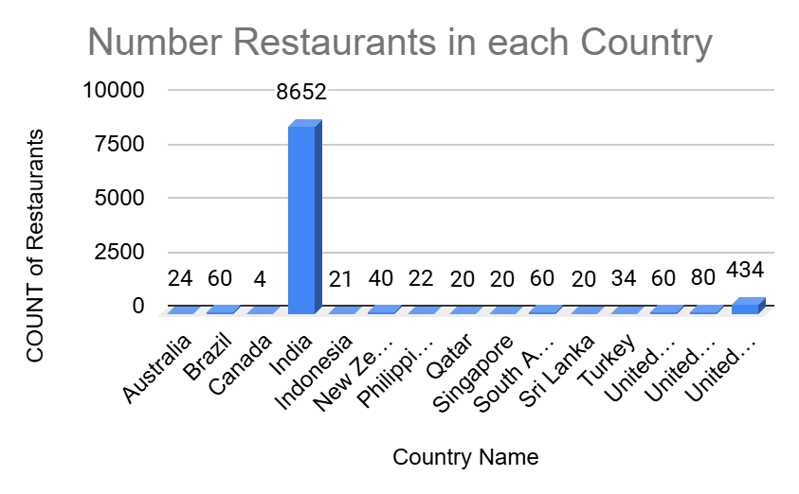
Identifying High-Demand Areas
Global Expansion Priority:
India has the highest number of restaurants (8652), indicating a strong presence. However, there could still be potential for further expansion, especially in emerging urban areas.
United States (434) and United Kingdom (80) also show significant restaurant counts, making them important markets for maintaining or expanding Zomato's footprint.

Slide 7
Countries with Potential for Growth:
Countries like Canada (4), Singapore (20), Sri Lanka (20), and Qatar (20) have relatively few restaurants. These countries may present opportunities for expansion to meet growing demand for restaurant services.
Australia (24) and New Zealand (40) might also present opportunities to increase Zomato's market share, especially if Zomato can introduce unique restaurant categories or innovative dining experiences
Developing and Emerging Markets:
Brazil (60), South Africa (60), and Turkey (34) have moderate numbers of restaurants but may still offer opportunities for growth in urban areas or through specific cuisine offerings.
Indonesia (21) and Philippines (22) have potential for future growth due to their increasing middle class and appetite for varied dining experiences.
Market Saturation:
Countries like India, United States, and United Kingdom are likely nearing or at market saturation, so Zomato might focus on improving its operational efficiencies, customer experience, and exploring underserved niches in these countries.

Slide 8
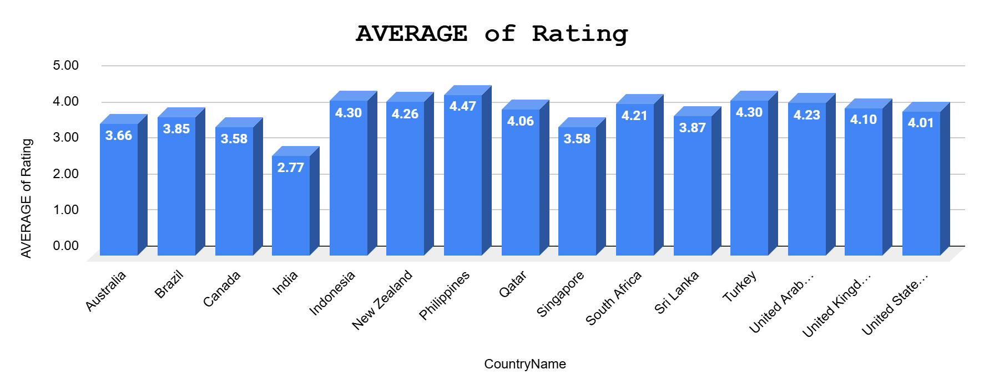
Country-wise Restaurant Ratings
Philippines (4.47), Indonesia (4.30), Turkey (4.30), and New Zealand (4.26) stand out as the countries with the highest average ratings.
Countries like Australia (3.66), Brazil (3.85), Qatar (4.06), and United Kingdom (4.10) have ratings in the 3.5 - 4.1 range, suggesting a moderate level of customer satisfaction.
Canada and Singapore are also on the lower end of the scale with ratings of 3.58

Slide 9
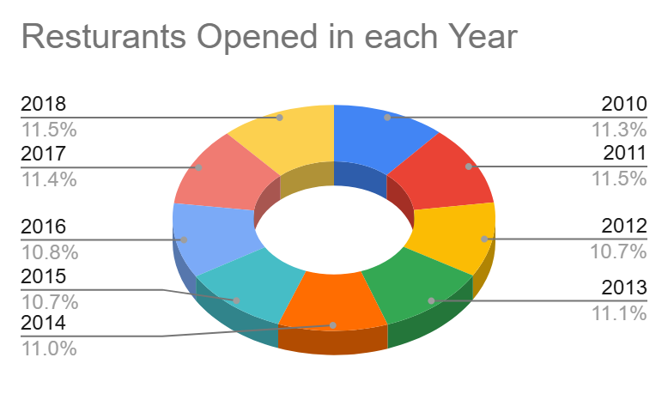
Yearly Restaurant Trend Analysis
Over the 9-year span (2010-2018), the total number of restaurants has seen steady growth.
The highest growth was observed between 2011 and 2012, where the number of restaurants went from 1,098 to 1,022, followed by a slight drop in numbers.
Overall, Zomato has successfully maintained a steady number of restaurant openings with slight fluctuations, indicating a stable growth pattern.

Slide 10
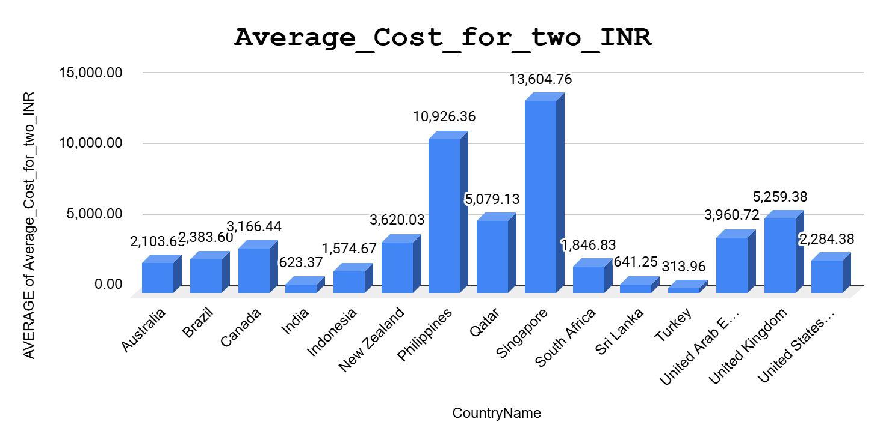
Cost Comparison: Dining for Two by Country
Average Cost for Two (INR):
India has the lowest average cost for two, at ₹623.37, which indicates a more affordable dining experience.
Singapore has the highest average cost for two, at ₹13,604.76, suggesting a premium dining market with higher spending.
Philippines and Sri Lanka have relatively higher costs for two, at ₹10,926.36 and ₹641.25, respectively, in contrast to their other regional counterparts.
General Pattern:
Western countries like the United States, United Kingdom, Canada, and Australia tend to have a higher average cost for two.
Asian countries like India, Indonesia, and Sri Lanka have lower costs, making them more affordable markets for customers.
Middle Eastern countries like Qatar, United Arab Emirates, and Turkey have moderate to high average costs, reflecting the varied economic conditions.

Slide 11
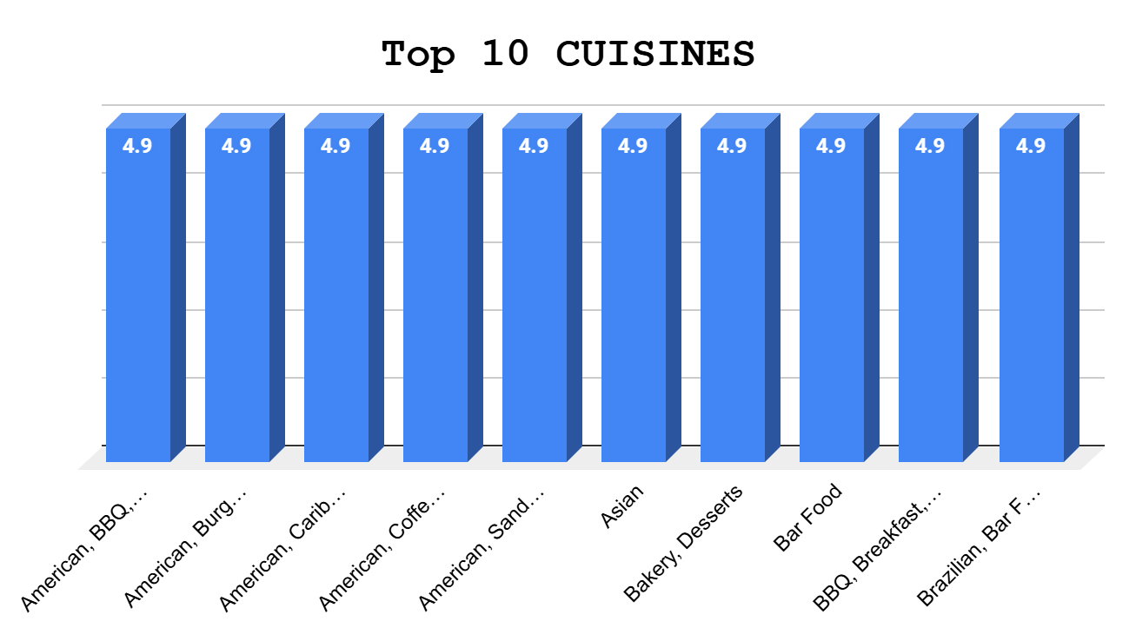
Top 10 Cuisines with Highest Ratings
Dominance of American and Asian Cuisines: A clear trend shows that American-themed cuisines (BBQ, Sandwich, Burger, etc.) dominate the highest ratings. These can be popular themes to consider for further restaurant concepts.
International Influence: Cuisines like Brazilian, Mexican, and Filipino highlight a blend of diverse and international tastes. This opens up opportunities for introducing culturally diverse food experiences.
Variety of Categories: The cuisines cover a range of categories such as BBQ, Seafood, Desserts, Bakery, and more. It suggests that customers appreciate variety, and there's potential for fusion restaurant concepts.

Slide 12
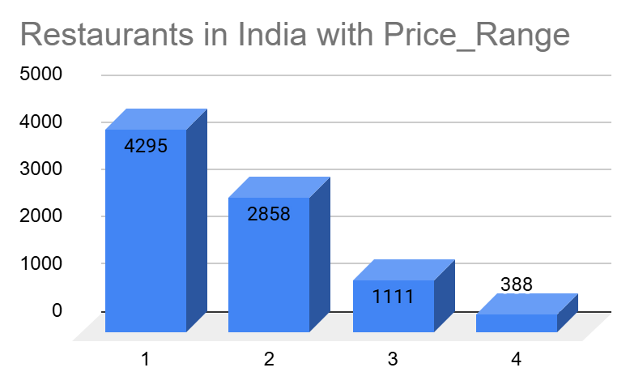
Price Range Analysis of Indian Restaurants
Dominance of Price Range 1: The majority of the restaurants in India (approximately 50%) fall within the Price Range 1 category, which indicates affordability and value-oriented dining. This price range likely targets middle-income customers or those looking for budget-friendly options.
Price Range 2 & 3: A significant portion of restaurants also falls into Price Range 2 (around 33%), showing that there is a substantial market for mid-range restaurants offering moderate pricing for a more diverse dining experience.
Price Range 4 (Premium Restaurants): Only about 4.5% of the restaurants are in Price Range 4, indicating that the premium market in India is relatively smaller compared to affordable and mid-range options. However, this also represents a lucrative segment for high-end dining experiences.

Slide 13
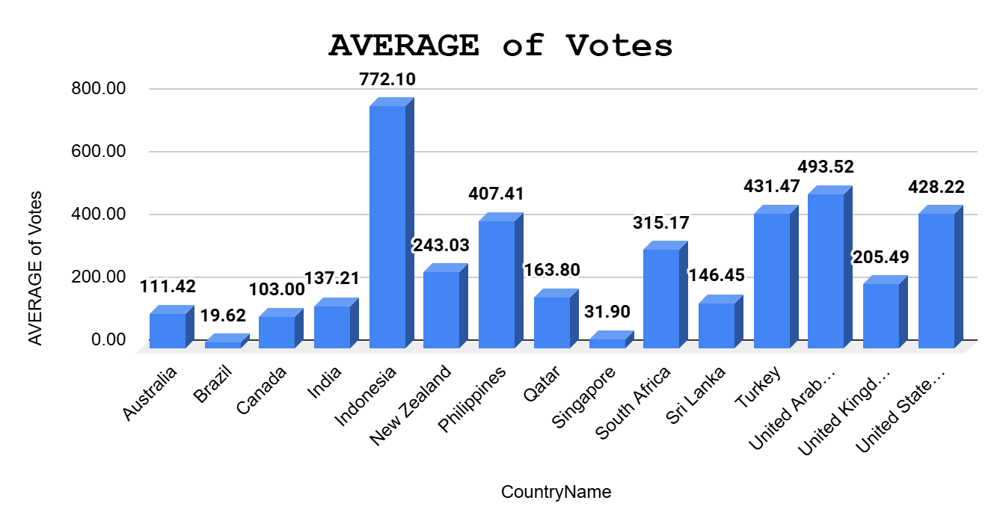
Restaurant Voting across Countries
Top Performers: United Arab Emirates (493.52) and Turkey (431.47) have the highest average votes, indicating significant customer interaction and popularity. Philippines (407.41) and United States of America (428.22) also have high customer engagement.
Countries with Lower Engagement: Brazil (19.62), Singapore (31.90), and Canada (103.00) have relatively lower average votes, potentially indicating a smaller or less engaged customer base.
Noteworthy Trends: India (137.21), with a larger restaurant base, shows moderate engagement levels. This could be a strategic insight into targeting higher engagement in the future through marketing or promotions. Indonesia (772.10) has a very high average, which might reflect a strong local food culture or a particularly popular cuisine in this region.

Slide 14
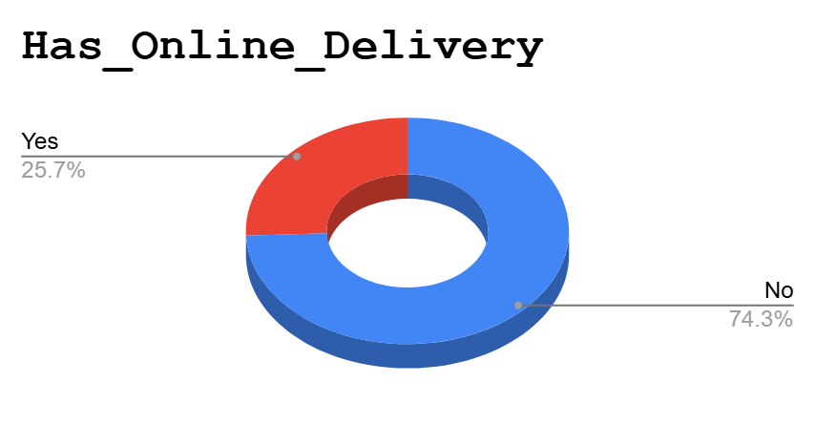
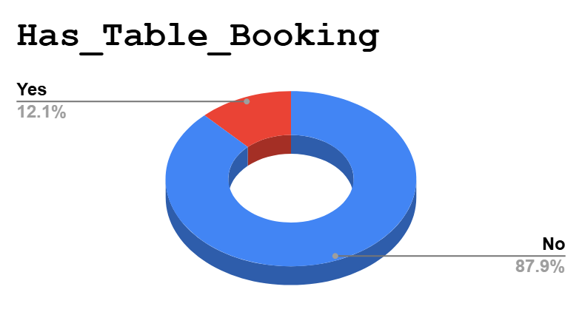
Restaurants with Table Booking & Online Delivery
A total of 8,393 restaurants do not offer table booking, while 1,158 restaurants provide this service.
Offering table booking may be a key differentiator in terms of customer experience and satisfaction, particularly in high-traffic or upscale markets.
A total of 2,451 restaurants offer online delivery, whereas 7,100 do not.
Offering online delivery can boost customer satisfaction and ratings. As demand for delivery services continues to rise globally, restaurants with delivery options are likely to attract more customers, especially in fast-paced environments or during peak dining times.

Slide 15
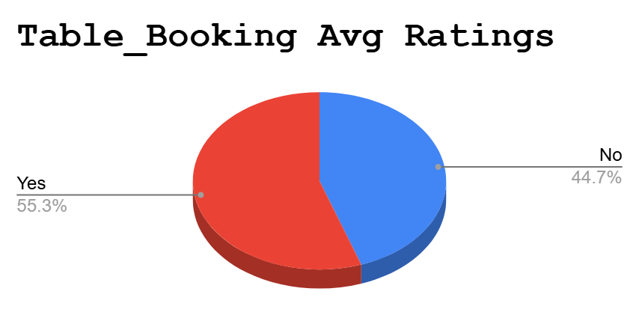
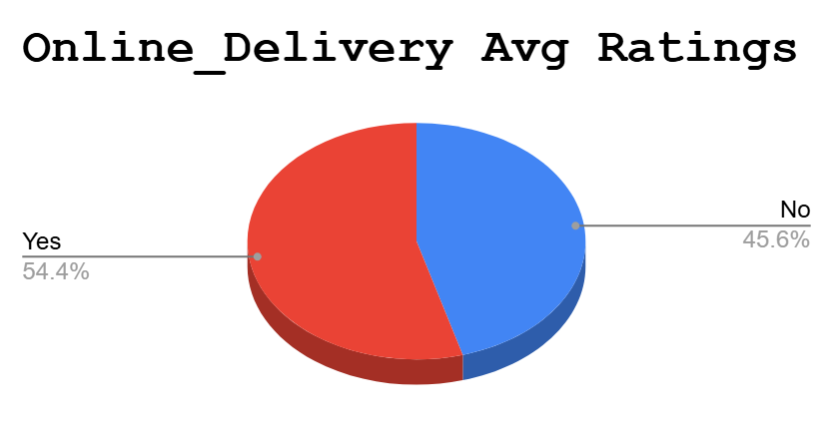
Rating: Online Delivery & Table Booking
Restaurants that offer table booking tend to have a higher average rating of 3.48 compared to those that don’t, which have an average rating of 2.81. This suggests that customers value the convenience and exclusivity that table booking provides, leading to higher satisfaction.
Restaurants with online delivery have an average rating of 3.29, which is higher than the 2.75 rating for those without online delivery. This indicates that customers appreciate the added convenience of delivery services, which could be driving positive ratings and customer loyalty.

Slide 16
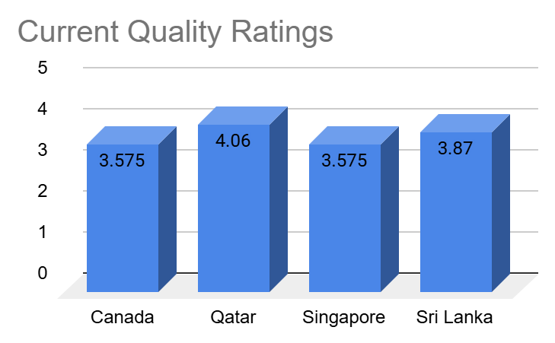
Identifying Prime Expansion Opportunities
Qatar is the top choice for expansion due to its high customer satisfaction ratings, presenting an opportunity for premium or high-quality restaurant concepts.
Sri Lanka, with its solid rating and growing market, offers an attractive opportunity for moderately priced yet high-quality dining.
Canada and Singapore have more competitive markets with opportunities for improving customer satisfaction through quality and innovation.

Slide 17
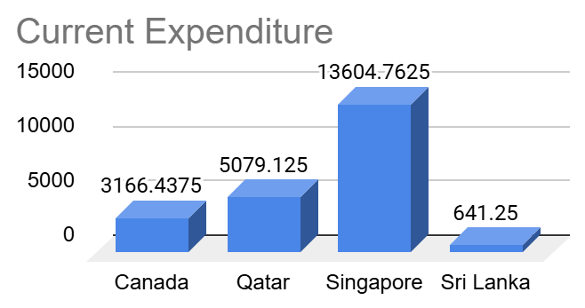
Identifying Prime Expansion Opportunities
Qatar and Singapore provide opportunities for high-end, premium restaurants, capitalizing on the higher average expenditure.
Canada represents a balanced market with a moderate cost for dining, allowing for mid-range options targeting middle-income consumers.
Sri Lanka is more suited for budget-friendly restaurants, with an emphasis on value and affordability.

Slide 18
Zomato Restaurants Analysis
The dashboard features slicers for selecting Country Name and Year, allowing users to filter and analyze data for a particular country or year.
There are a total of 9,551 restaurants spread across 15 countries and 141 cities. The average cost for two people is 856, and the average rating is 2.89. The total number of votes is 1,498,645 and there are 1,825 different cuisines available.
The highest number of restaurants were opened in 2018, with a total of 1,102 restaurants.
Restaurants offering online delivery have a lower average rating (2.75) compared to those without online delivery (3.29), which may point to potential service-related concerns.
Similarly, restaurants with table booking have an average rating of 2.81, while those without table booking tend to have higher ratings (3.48), indicating that customers may prefer the flexibility of spontaneous dining.
India has the highest number of restaurants, with 8,652 establishments, followed by the USA with 434 and the UK with 80. The price range distribution differs across countries, highlighting the varying market segments in each region.

Slide 19
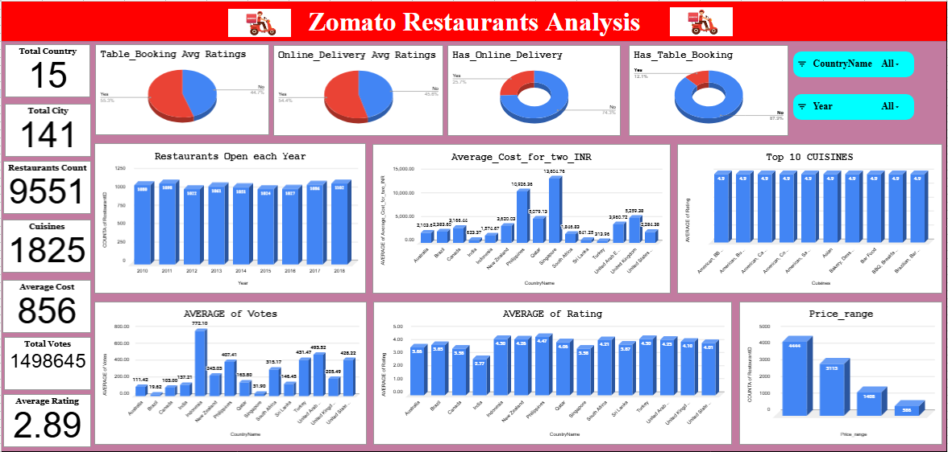
Dashboard

Slide 20
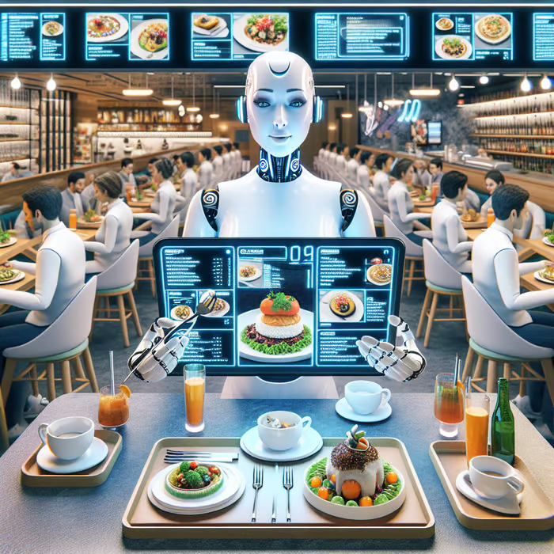
Conclusion
Raw Data: The dataset consists of 2 tables with attributes like location,country name,year,locality,price,ratings, cities,etc
Restaurants Count: India has the largest number of restaurants (8,652), while countries such as Canada, Qatar, Singapore, and Sri Lanka offer lower competition, making them attractive options for expansion.
Restaurants Ratings: Restaurants that offer online delivery and table booking services tend to have higher ratings, indicating a positive correlation between these services and customer satisfaction. Higher-rated establishments are more likely to provide these conveniences.
Popular Cuisines and Customer Preferences: Cuisines like Japanese, Seafood, and American,BBQ consistently achieve high ratings (4.5), making them excellent choices for new restaurant menus due to their strong customer appeal.
Market Expansion Focus: Target cost-effective countries such as Canada, Sri Lanka, and Qatar for budget-friendly options, while capitalizing on high-spending markets like Singapore for premium pricing.
Slicer: Slicers were utilized to filter the data interactively by country Name and Year for more dynamic and insightful analysis.

Slide 21


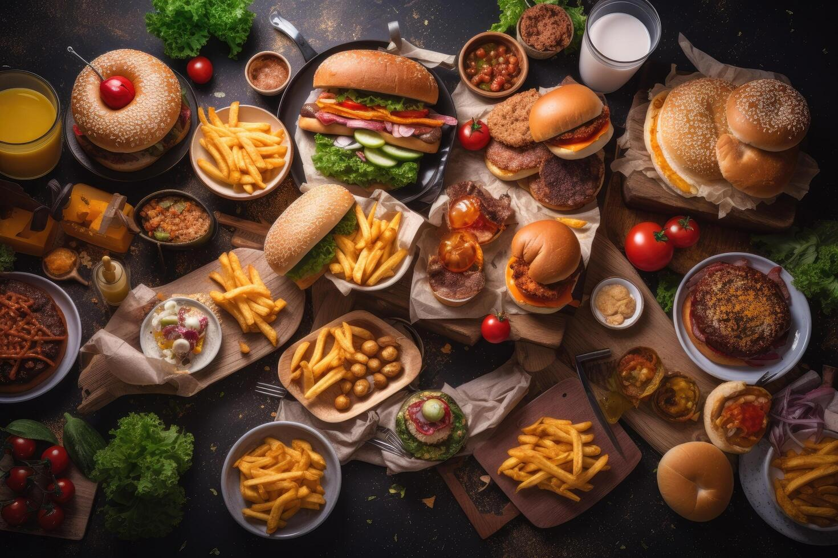
Thank You.

